Slide 1

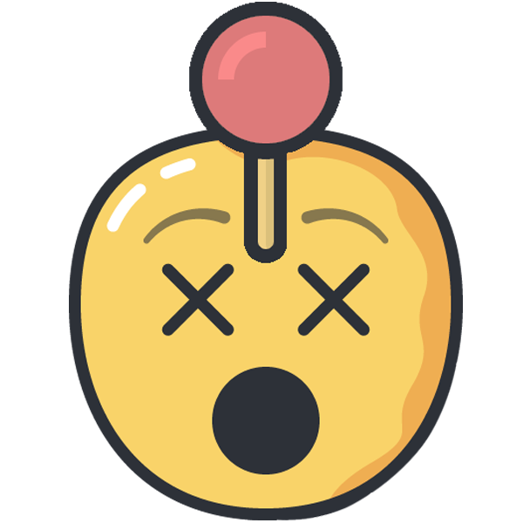
Human Gamepad
Infinite games, infinite fun!
Notes:
https://pixabay.com/en/notebook-work-girl-computer-woman-2386034/
Have more fun, together!

Slide 2
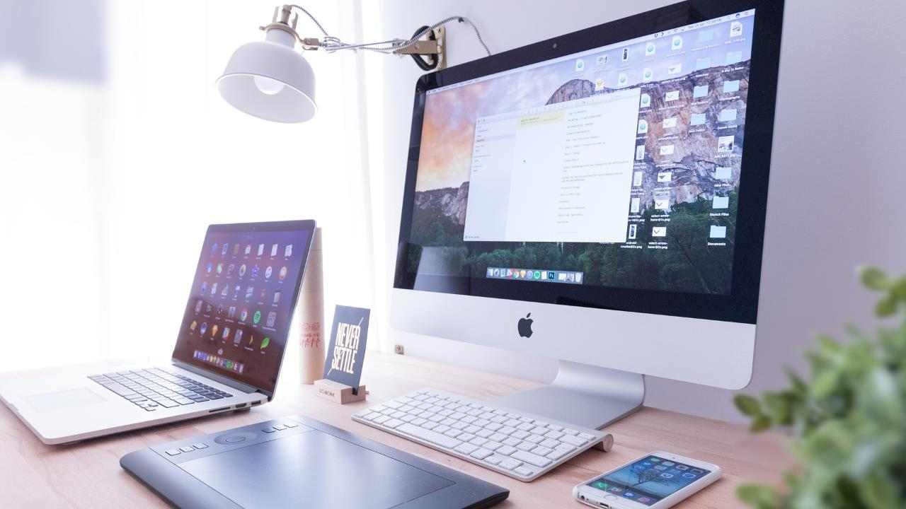
Do you play games?
Notes:
Hands up who plays some computer games! (Seems you are a bit ashamed to admit that, but I would assume most of you play).
Well, and I am pretty sure, that you have that one game, you played when you were children. Duke Nukem 3D? Wolfenstein? Need for Speed Undergroung are mine for instance. And those games were a lot of fun, but Do I play them today? Not anymore. I played them for so long that – well – the fun is gone, they are way too familiar.

Slide 3
Duke Nukem 3D

Slide 4
Wolfenstein 3D

Slide 5
Need for Speed

Slide 6
Fun ???
Notes:
But What if I told you there is a way to enjoy the games once again. To share that joy with your friends, and to make virtually any game a multiplayer cooperative party game. Let’s see how it works.

Slide 7
Cooperation !!!
Notes:
The idea is pretty simple. Each of the players is responsible only for fraction of the controls, they have to cooperate and talk to each other to be successful. Say, Martin, Kamil and Petr meet on a party and would love to play Doom, together. So with our app, they can share the control of the main character in a way, that Martin here is responsible for looking around. Kamil is responsible for the movement, and Petr for shooting. So, together they form a sort of “Human Gamepad”.

Slide 8
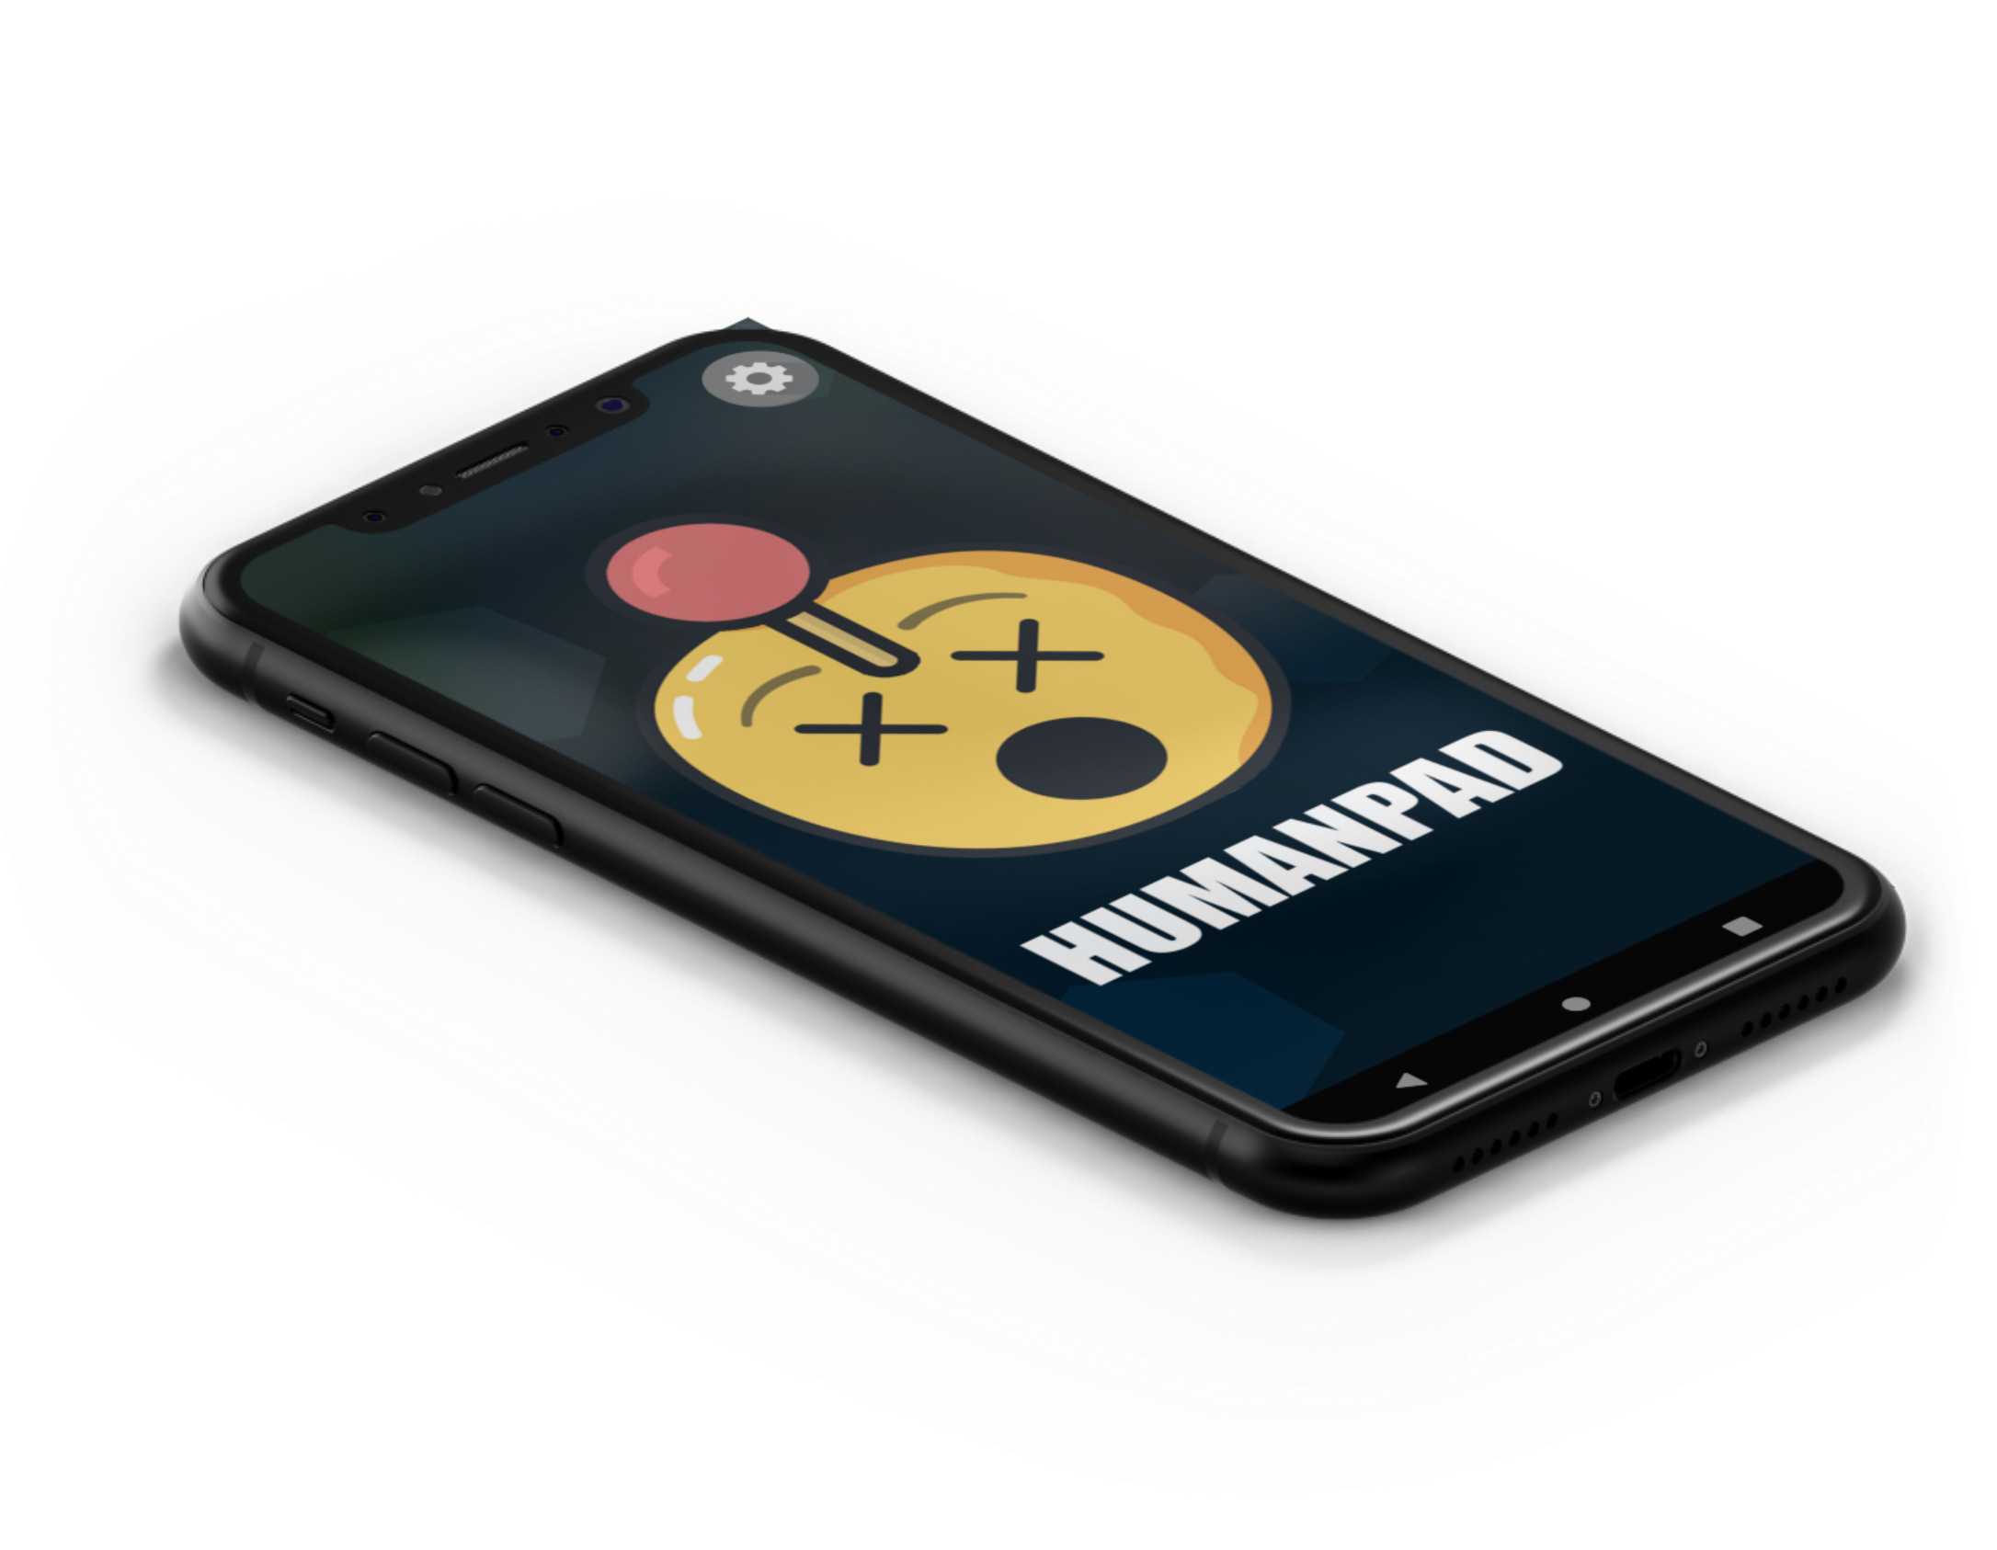
Notes:
The idea is pretty simple. Each of the players is ontrol of the main character responsible only for fraction of the controls, they have to cooperate and talk to each other to be successful. Say, Martin, Kamil and Petr meet on a party and would love to play Doom, together. So with our app, they can share the cin a way, that Martin here is responsible for looking around. Kamil is responsible for the movement, and Petr for shooting. So, together they form a sort of “Human Gamepad”.

Slide 9
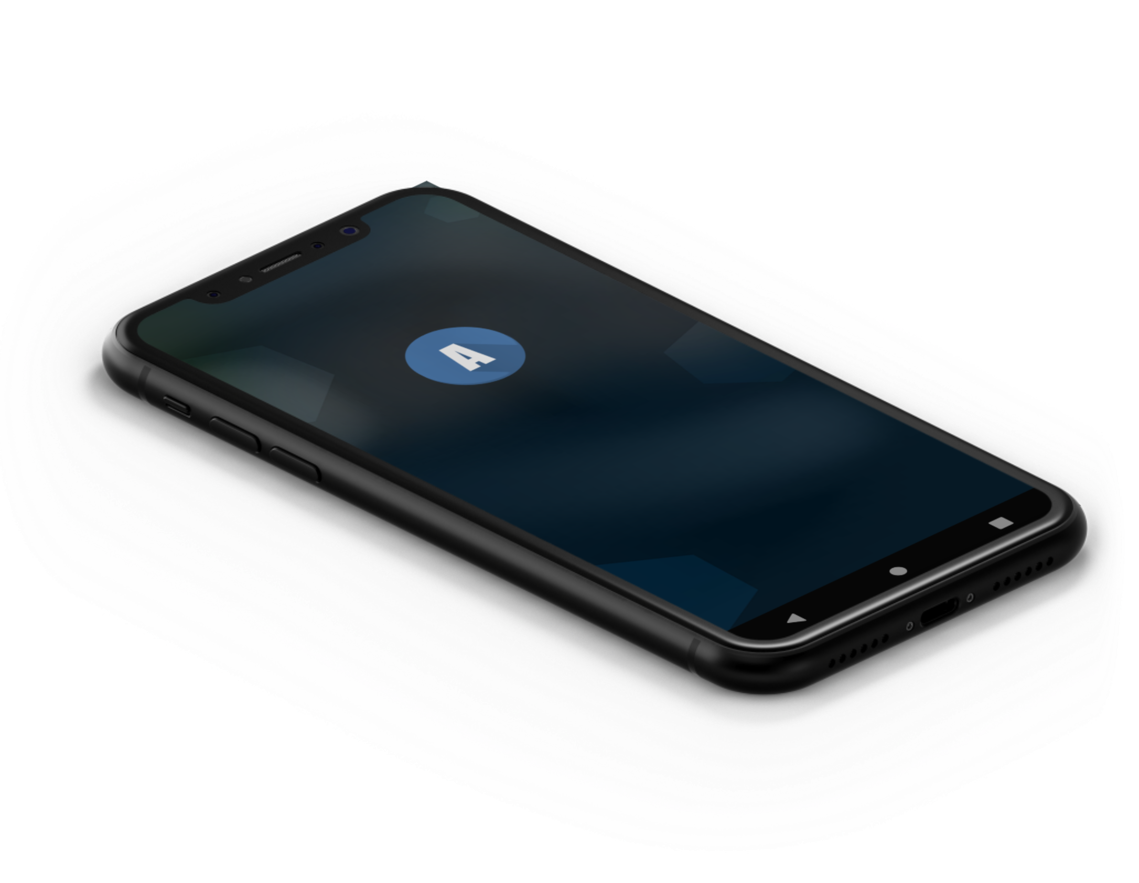
Notes:
The idea is pretty simple. Each of the players is responsible only for fraction of the controls, they have to cooperate and talk to each other to be successful. Say, Martin, Kamil and Petr meet on a party and would love to play Doom, together. So with our app, they can share the control of the main character in a way, that Martin here is responsible for looking around. Kamil is responsible for the movement, and Petr for shooting. So, together they form a sort of “Human Gamepad”.

Slide 10
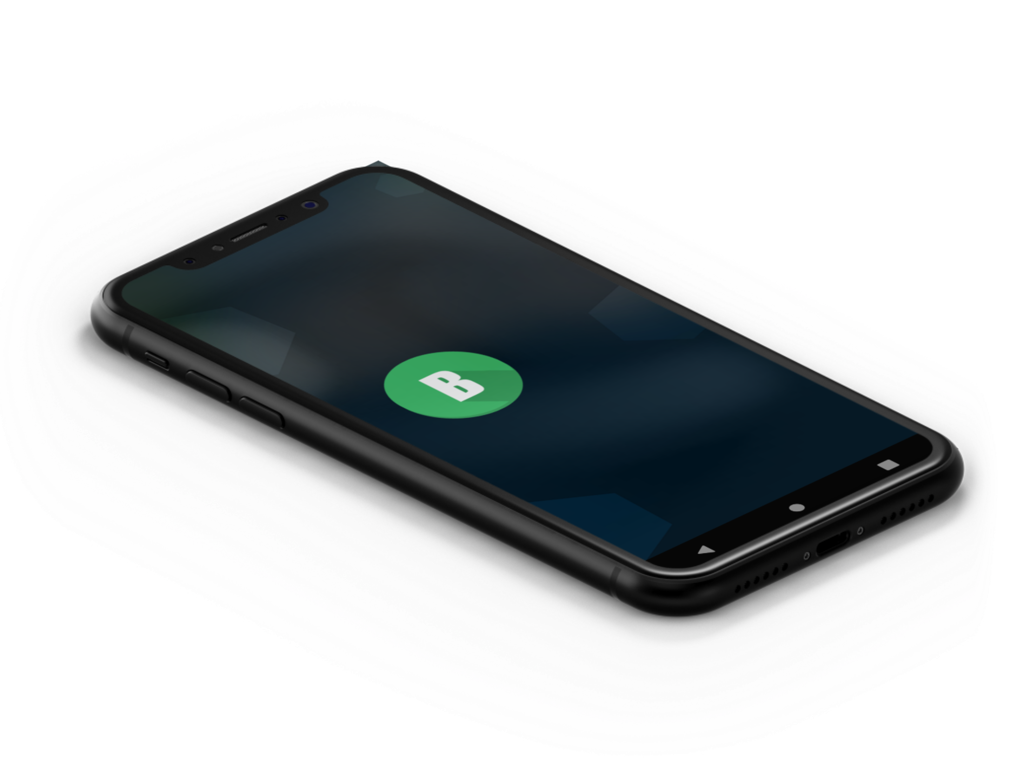
Notes:
The idea is pretty simple. Each of the players is responsible only for fraction of the controls, they have to cooperate and talk to each other to be successful. Say, Martin, Kamil and Petr meet on a party and would love to play Doom, together. So with our app, they can share the control of the main character in a way, that Martin here is responsible for looking around. Kamil is responsible for the movement, and Petr for shooting. So, together they form a sort of “Human Gamepad”.

Slide 11
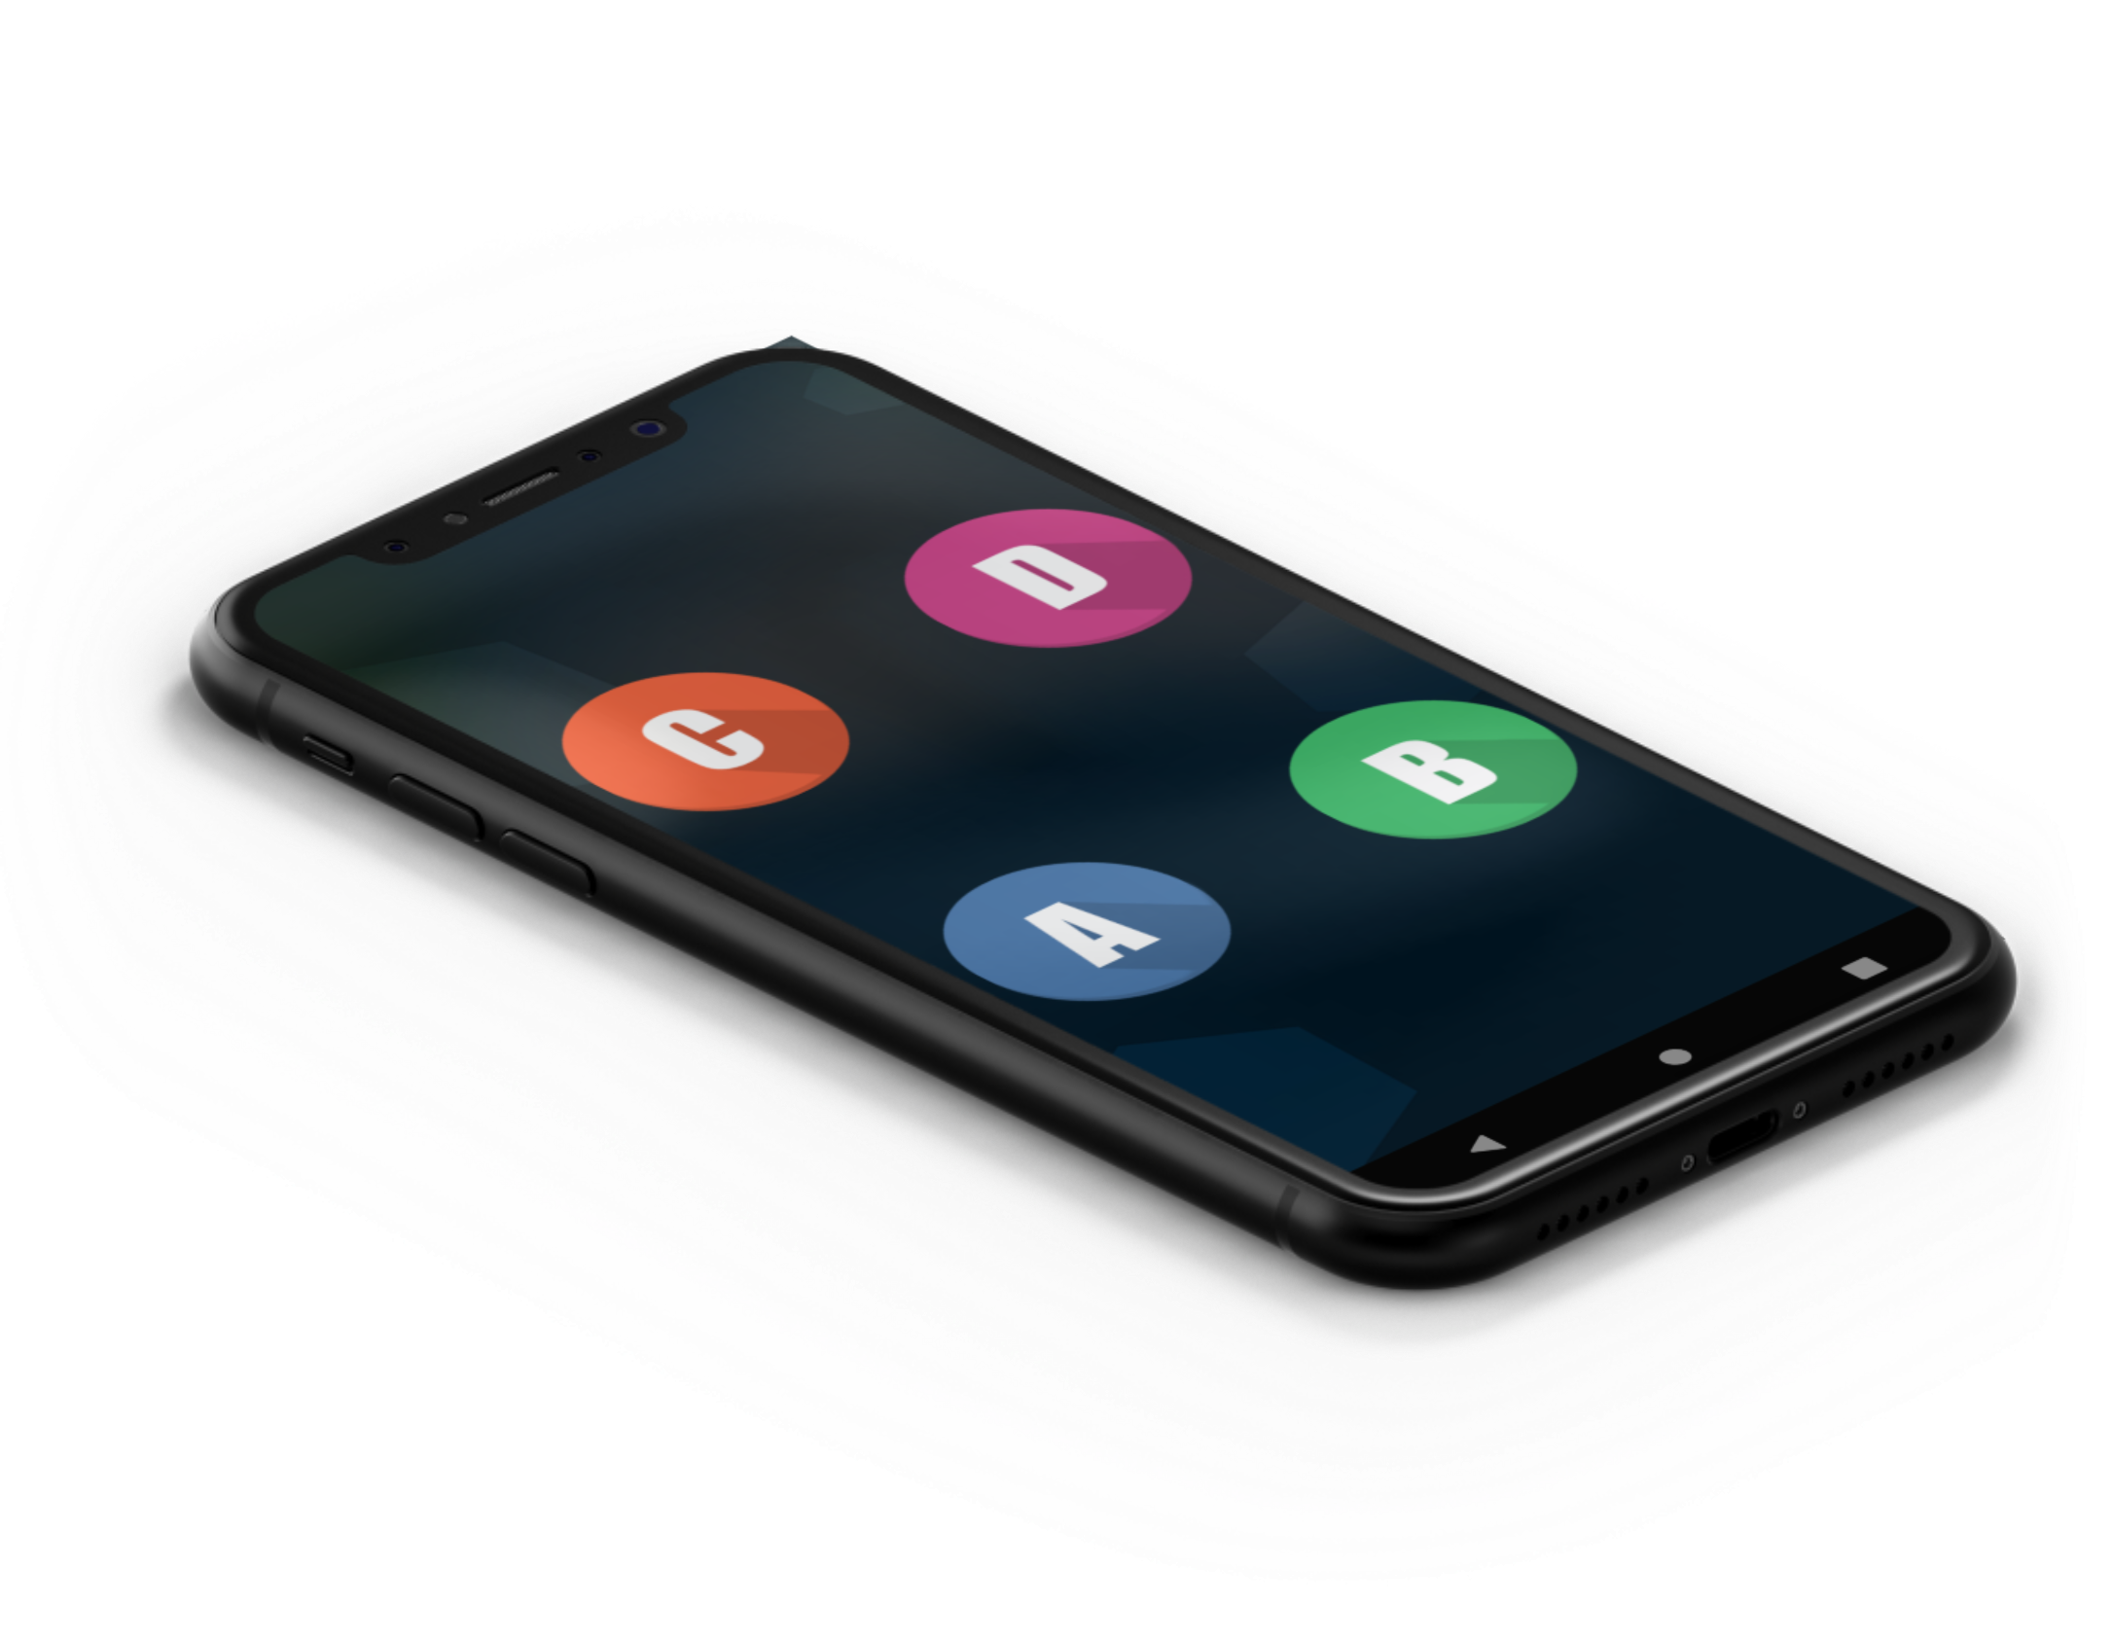
Notes:
The idea is pretty simple. Each of the players is responsible only for fraction of the controls, they have to cooperate and talk to each other to be successful. Say, Martin, Kamil and Petr meet on a party and would love to play Doom, together. So with our app, they can share the control of the main character in a way, that Martin here is responsible for looking around. Kamil is responsible for the movement, and Petr for shooting. So, together they form a sort of “Human Gamepad”.

Slide 12
Real world test
Notes:
Lets see how that works in real life:
Martin here, is tilting his phone too look around
Kamil has buttons to move back and forth
And Petr has to jump to shoot
(Honestly I think this is funny and we have not yet even started)

Slide 13
Simple
Notes:
Isn’t it beautiful? We allow you, to have fun in a way you could not imagine before. Thanks to the simple design, you can play almost infinite number of games, and you need only a small Raspberry Pi and your Android phone and if you want to, you can already download the app on Google play, and the Raspberry sources on our GitHub.
And for the future versions of our app? In theory we an get rid of the Raspberry Pi completely, we can add more sensors, we can add “crazy mode” which changes the controls for the players after every 30 seconds or so, and we would like to add support for multiple teams competing against each other. The possibilities are infinite and are just around the corner.

Slide 14
Enjoy!
Notes:
Enjoy your favourite games with your friends!

Slide 15
Notes:
Hands up who plays some computer games! (Seems you are a bit ashamed to admit that, but I would assume most of you play).
Well, and I am pretty sure, that you have that one game, you played when you were children. Duke Nukem 3D? Wolfenstein? Need for Speed Undergroung are mine for instance. And those games were a lot of fun, but Do I play them today? Not anymore. I played them for so long that – well – the fun is gone, they are way too familiar.
But What if I told you there is a way to enjoy the games once again. To share that joy with your friends, and to make virtually any game a multiplayer cooperative party game. Let’s see how it works.
The idea is pretty simple. Each of the players is responsible only for fraction of the controls, they have to cooperate and talk to each other to be successful. Say, Martin, Kamil and Petr meet on a party and would love to play Doom, together. So with our app, they can share the control of the main character in a way, that Martin here is responsible for looking around. Kamil is responsible for the movement, and Petr for shooting. So, together they form a sort of “Human Gamepad”.
Lets see how that works in real life:
Martin here, is tilting his phone too look around
Kamil has buttons to move back and forth
And Petr has to jump to shoot
(Honestly I think this is funny and we have not yet even started)
Isn’t it beautiful? We allow you, to have fun in a way you could not imagine before. Thanks to the simple design, you can play almost infinite number of games, and you need only a small Raspberry Pi and your Android phone and if you want to, you can already download the app on Google play, and the Raspberry sources on our GitHub.
And for the future versions of our app? In theory we an get rid of the Raspberry Pi completely, we can add more sensors, we can add “crazy mode” which changes the controls for the players after every 30 seconds or so, and we would like to add support for multiple teams competing against each other. The possibilities are infinite and are just around the corner.

